Slide 1
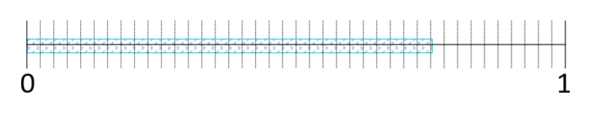
Pre-Session Table Task
Write as many equivalent fractions as you can for the following fraction:
Notes:
<<Note to Presenter: text enclosed by << >> are notes for the presenter and not part of the script>>
<<Participants will do this at their table before the session starts. This task will be debriefed later in the session. >>

Slide 2
Comparing Fractions Math For Teaching
Notes:
Welcome, thank everyone for coming, I am _______________

Slide 3
Learning Focus
Participants will:
Explore the impact of using intentionally selected representations.
Use number lines to develop fraction number sense.
Compare fractions using a variety of strategies and tools.
Connect research to practice.
Notes:
These ideas will form the learning focus for our work today. <<read each bullet followed by the corresponding information below.>>
(Bullet 1): Visual representations enhance students intuitive understanding of operations and ready them for formal procedures.
(Bullet 2): In North American instruction we tend to overemphasis procedures in fraction instruction, preventing students from making connections to their prior knowledge.
(Bullet 3): Opportunities to debrief and share thinking help teachers and students expand their understanding and consolidate their learning.

Slide 4
Session Norms
Be engaged in the tasks and discussions as this enriches everyone’s experience.
Be a learner – it is fun!
Actively seek connections between the research and your classroom experience.
By better understanding student thinking we better understand the impact we can have on their learning.
Notes:
These are our session norms.

Slide 5
Agenda
 | Intended Audience
Activity: Pre session table task | Student
Overview of the Research | Educator
Activity: Partitioning Rectangles | Student
Using number lines | Educator/Student
Understanding equivalency | Educator/Student
Understanding density | Educator/Student
Curriculum connections task | Educator
Activity: Exploring mathies.ca | Educator
Notes:
This is what we will be doing in this session. Notice that we have identified the intended audience for the activities. The activities designated as Educator are not intended to be used with students.
Since this is a long session, we haven’t included all of the individual activities in the agenda. There are several activities in the Understanding equivalency section, and there are also some in the Understanding density section.

Slide 6
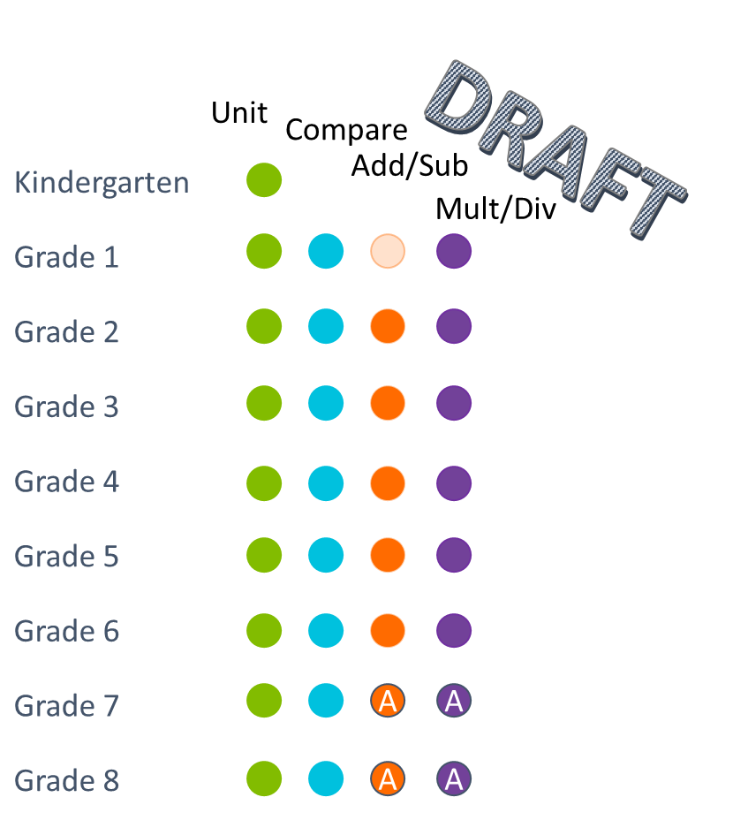
The FLP Across the Elementary Grades
Notes:
<<This slide was shown in the Unit Fraction session. Coloured dots indicate that knowledge and skills related to the corresponding cluster (e.g., green – unit) are included in that grades learning. Light shading indicates the learning is implicit. An A shows where algorithms or procedures may be introduced.>>
Students explore equivalent fractions using concrete materials in grade 4; they focus on the multiplicative relationships in grade 5; they explore addition and subtraction in grade 2 when they compose fractions; they explore multiplication for example: when you have 6 cookies and each person can have half of a cookie – how many people can you feed? OR, you have 6 people so how many cookies do you need?

Slide 7
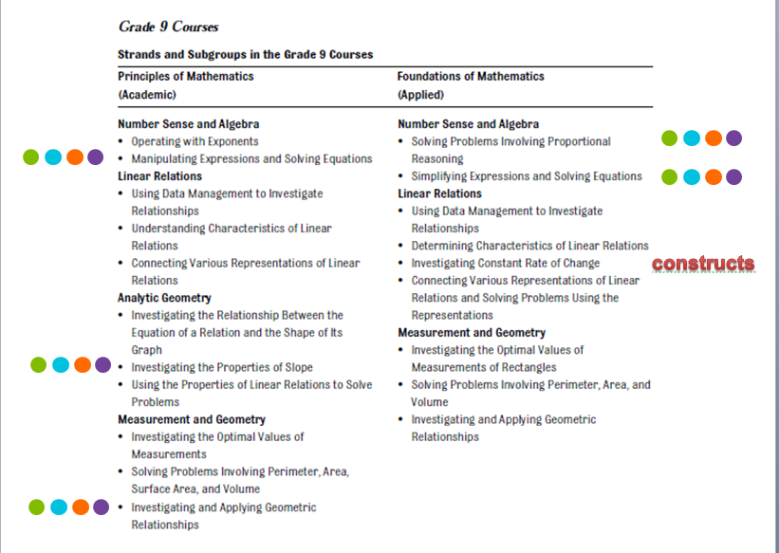
Fractions Across the Grade 9 Courses
Multiply/Divide
Add/Subtract
Compare
Unit
Notes:
<<Slides 7-9 were shown in the last session>>
Let’s revisit: this slide illustrates the connections to the Fractions Learning Pathways. The green dots represent Unit Fractions, turquoise dots are Comparing Fractions, orange dots refer to Operations: Adding and Subtracting and the purple dots are Operations: Multiplying and Dividing. The Multiplying and Dividing part of the Pathways is still under development. This slide shows Grade 9 connections.

Slide 8
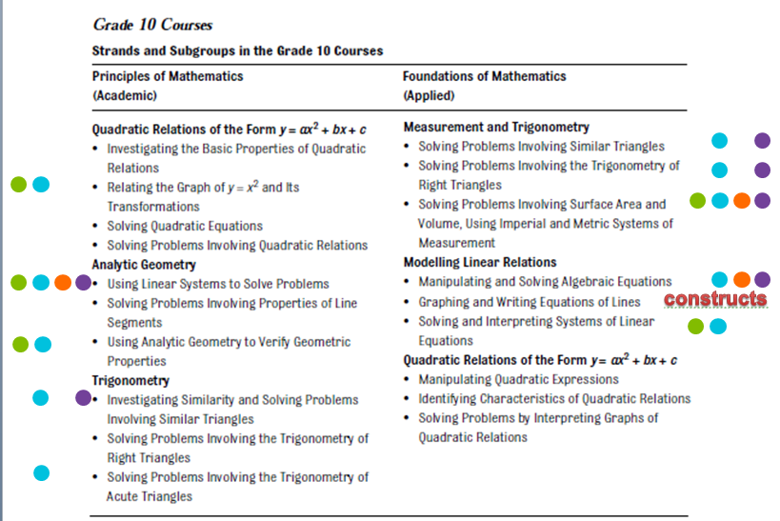
Fractions Across the Grade 10 Courses
Multiply/Divide
Add/Subtract
Compare
Unit
Notes:
<<This slide was shown in the last session>>
Let’s revisit: this slide illustrates the connections to the Fractions Learning Pathways. The green dots represent Unit Fractions, turquoise dots are Comparing Fractions, orange dots refer to Operations: Adding and Subtracting and the purple dots are Operations: Multiplying and Dividing. The Multiplying and Dividing part of the Pathways is still under development. This slide shows Grade 10 courses.

Slide 9
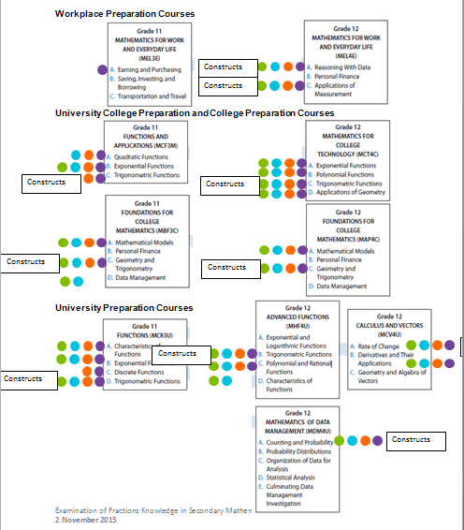
Fractions Across Grades 11 and 12
Multiply/Divide
Add/Subtract
Compare
Unit
Notes:
<<This slide was shown in the last session>>
Let’s revisit: this slide illustrates the connections to the Fractions Learning Pathways. The green dots represent Unit Fractions, turquoise dots are Comparing Fractions, orange dots refer to Operations: Adding and Subtracting and the purple dots are Operations: Multiplying and Dividing. The Multiplying and Dividing part of the Pathways is still under development. This slide shows Grade 11 and Grade 12 courses.

Slide 10
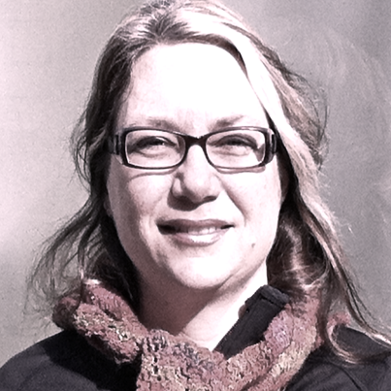

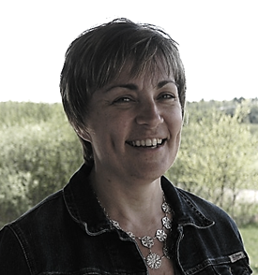



The Fractions Research Team 2011-2014
Curriculum and Assessment Policy Branch
TRENT MATHEMATICS EDUCATION RESEARCH COLLABORATIVE
DSBN
HWDSB
KPRDSB
OCDSB
SCDSB
SMCDSB
TLDSB
YCDSB
Cathy Bruce
Tara Flynn
Shelley Yearley
Rich McPherson
Sarah Bennett
Notes:
<<This slide was also included in the Unit Fractions sessions so if the participants have heard the script, just acknowledge again the substantial amount of research with underpins today’s learning.>>
We have alluded to the research many times during this session. We are pleased to be here sharing the work that has resulted from a large network of participants and funding partners. This research is based in student thinking, grounded in international and national research, and field-tested in Ontario classrooms.
The research team has been engaged in collaborative action research (which means that a small group of classroom teachers [approx. 6 in our groups] meet with the research team for approx. 6 days over the course of several months; they use a pre-assessment to identify student needs and then co-plan next steps; the group observes students’ mathematical thinking by watching them in a class as they complete a task or watching a small group of students complete a task in an alternative site, such as the library; a post assessment allows the research team to correlate the activities to improvements in student understanding). This Ontario based research emerges from our local context.
The Collaborative Partners are Trent University, Government of Canada, and the Ministry of Education. That the Ontario Ministry of Education is involved in education research and supports is pretty unique within the broader international context. We are lucky to be working in Ontario.

Slide 11
Overarching Research Question
What instructional strategies support junior and intermediate grade students in the learning of fractions, an area of mathematics that is typically viewed as ‘difficult’ to learn?
Notes:
With the research in mind, the overarching research question looks at: what instructional strategies support junior and intermediate grade students in the learning of fractions, an area of mathematics that is typically viewed as ‘difficult’ to learn?
Through the phases of the project, other questions are being pursued and are predominantly related to testing the hypothesized learning pathways

Slide 12
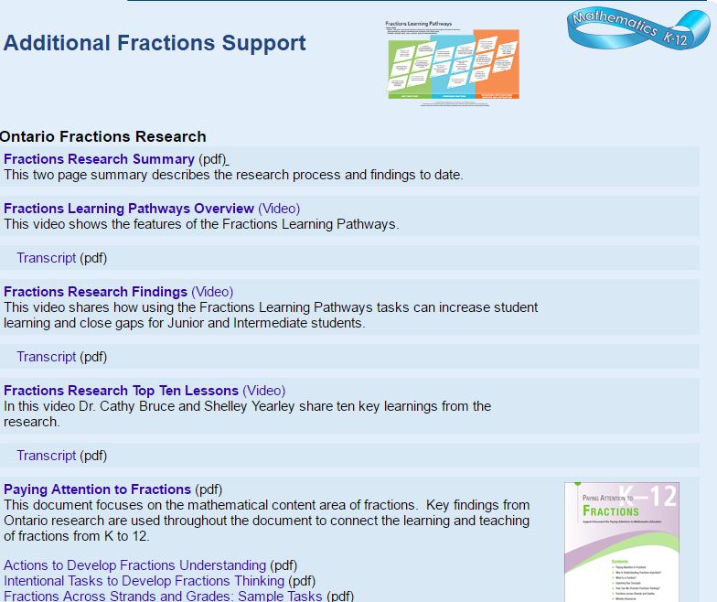
fractionsteaching.ca
Notes:
Remember that all the fractions resources are located at fractionsteaching.ca
This includes the Paying Attention to Fractions document, support documents (4) and the Adobe Presenter which allows you to hear more about the mathematics contained within the document. As well, research summary ‘one pagers’ and complete literature reviews are located here so that you can read the research yourself. The Fractions Learning Pathway is at the top and various videos and webinars allow you to personalize your learning. There is also a digital paper on the Professional Learning journey early in the research on represent, compare, and order.

Slide 13
Change in P Data and Post-Assessment Means, By Grade
Notes:
This data is from three board collaborative action research sites in the 2014-2015 school year. As previously described, the students in the eighteen classes wrote a pre-assessment and post-assessment. After the post assessment, teachers identified the specific needs of their students and implemented tasks to address those needs. This was a short interval – approximately three months. They did not spend every day focused on fractions but rather changed the types of tasks that they used with students to address fragile understandings in order to teach grade-level content. This graph shows the change in the aggregated means by grade.
Let’s look at the bottom two lines. The red line shows that the Grade 6 group increased by 10.5%. Interestingly, the Grade 9 locally developed students had a pre-mean lower than the Grade 6 students but managed to increase their understanding by 17%! The top two lines show that there is a ceiling to this knowledge as both the Grade 9 Enriched and Grade 10 Academic students shows minimal (or no) improvement– reinforcing that if we build the understanding students will be better prepared for success with subsequent mathematics studies.
The three lines in the middle represent Grade 7, Grade 8 and Grade 9 applied, each with increases. We believe it is never too late to support students in deepening their knowledge of fractions.

Slide 14
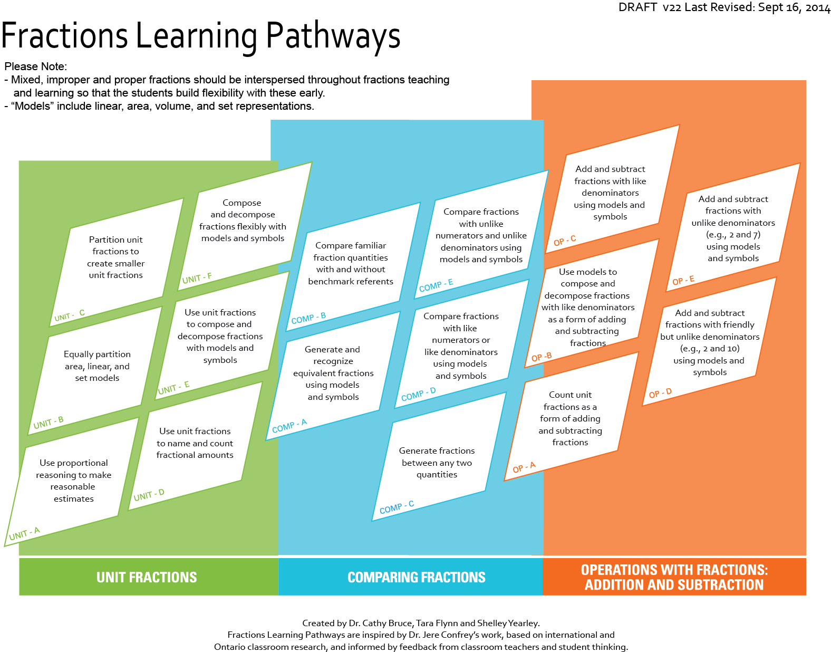
fractionslearningpathways.ca
Notes:
You have seen the Fractions Learning Pathways before during previous sessions. This is an on-line, interactive resource.
<<This is a review>>
You can see that there are three clusters – unit fractions, comparing fractions and operations: addition and subtraction. Each cluster is comprised of cells which identify the knowledge and skills that research has demonstrated are required for successful fractions understanding. Clicking on a cell brings you to a landing page, which has a brief summary of the research on the left and links to tasks on the right. Clicking on a task allows you to access the task template (written by teachers involved in the research) which includes all task templates, an implementation video/photo (sometimes), student thinking samples and related research links. The research team is currently working on two more clusters on multiplication and division.

Slide 15
Partitioning Rectangles
Construct a large rectangle on graph paper provided.
Partition your rectangle into fourths.
Shade in one one-fourth of your rectangle.
Now partition each of your fourths into thirds.
What fraction of the area is shaded using the new fractional unit?
Write a symbolic equation with these two fractions.
Notes:
<<Read instructions. Participants will do the activity individually at their table using the grid paper. This activity will be debriefed later in the session.>>

Slide 16
Using Number Lines
Notes:
At this point we are going to focus on representations.

Slide 17
What the research tells us…
There is a multitude of representations in North American textbooks (15-25) compared to Japanese texts (4)
The four are:
number lines
rectangular models
volume models
flats & rods
Notes:
This is about being more precise in our instructional decisions rather than adding to what we are already doing. Notice that circles are not one of the four representations used in Japanese textbooks.
It is not about doing more, it is about doing less and doing it better.
These 4 representations are powerful… we don’t need a multitude of representations and the research shows that we should definitely not be overusing circles.

Slide 18
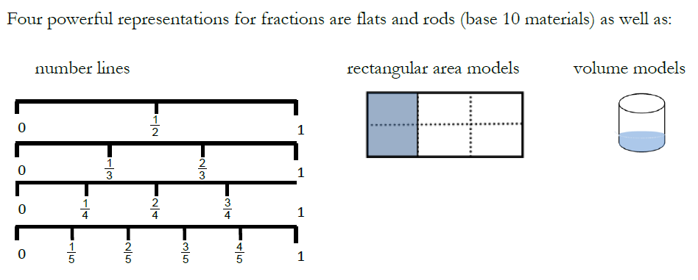
Math Teaching for Learning: Purposeful Representations
Notes:
The effectiveness of the consistent use of representations is supported by the findings of researchers Pirie and Kieran (1994)who found that students hold onto the representation they are initially exposed to as the grounding for their conceptual understanding. Since this is the case it makes sense to select precise representations that have longevity and power.

Slide 19
Purposeful Representations
These representations are used consistently in Japanese resources with the purpose of developing students’ understanding of fraction as quantity and to emphasize the underlying concepts of
expressing all fractions as a multiple of a unit fraction,
making comparisons based on like-units, and
identification of the whole
Notes:
<<(Watanabe, Murata, Okamoto, 2012)>>.
This set of representations strongly supports incorporating understanding of the different meanings of fractions into operations of fractions seamlessly because these representations are extremely flexible in their use as the complexities of the curriculum expectations build.

Slide 20
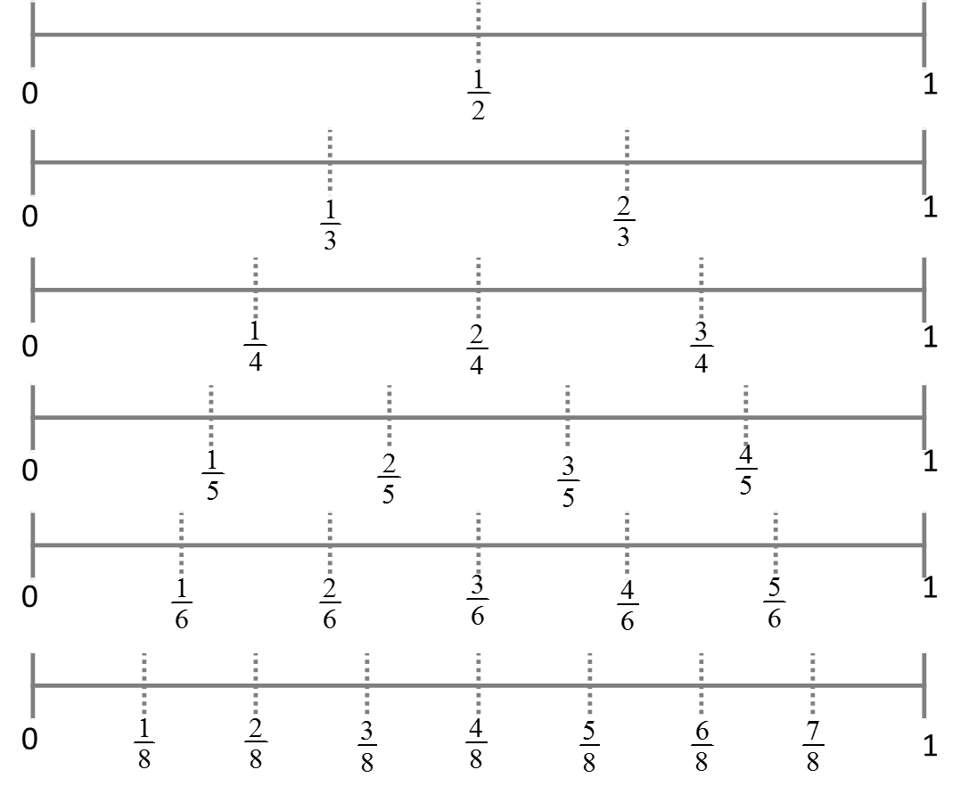
Fractions on Stacked Number Lines
Notes:
Japanese students have this model on their desks. We tend to have multiplication facts on Canadian desks. What are the possibilities for proportional, spatial and fractional thinking with this model? Might it help with multiplication facts as well?

Slide 21
Further Evidence
Two promising representations, as noted in the research to date, are bar or rectangular area models and number lines as a linear representation because both are more readily and accurately partitioned evenly for odd and large numbers of partitions. (Watanabe, 2012)
Number lines (linear measures) can effectively show proper and mixed fractions simultaneously and promote attention to the relationship of the numerator to the denominator. (Bruce, Chang, Flynn, Yearley, 2013)
Notes:
The research clearly shows that number lines are very effective for partitioning odd or large numbers,
whereas circles are difficult to equi-partition especially for odd or large numbers.
Precise selection of powerful representations can avoid the use of representations, such as the circle, which are difficult to equi-partition. This inaccuracy in partitioning leads to numerous incorrect conclusions.
As well, number lines can also show proper and mixed fractions simultaneously.

Slide 22
Effective Questioning
Johanning (2011) cautions that
using visual models such as fraction strips and number lines support students’ ability to visualize fractions and develop a sense of relative size. However, visual models are not enough. During instruction, students should routinely be asked to use their understanding of relative size to make sense of situations in which fractions are used operationally. (99)
(Bruce, Bennett and Flynn, 2014)
Notes:
The teacher plays a vital role: Asking the right questions supports students in knowing what to attend to and refines their understanding of the concepts. Asking students to explain their thinking uncovers both understandings and misconceptions.

Slide 23
Types of Number Lines
Empty number line
Open number line
Closed number line
0
0
50
Notes:
Here are examples of types of number lines. Too often we provide pre-made number lines that include the scale. Research shows that students are more cognitively engaged when using empty number lines.
The strategies promoted by the teacher should refine and push student thinking toward more elegant, sophisticated, and reliable strategies and procedures.

Slide 24
The research also tells us…
Students hold on to initial representations so what we introduce is important!
Circular area models are overrepresented (and typically used to introduce fractions) and pose difficulties (they are difficult to equi-partition into large or odd numbers AND students are not formally introduced to the concept of area of a circle until intermediate grades)
In North America, numeric - symbolic manipulation is privileged prematurely
Notes:
<<read each bullet and follow up with the corresponding comments below.>>
(Bullet 1) – Cathy Bruce tells us that there is research indicating that this is particularly true of females with learning disabilities – they will persist with ineffective representations, such as the circle, when trying to solve a mathematical task, far longer than other students, who move on to more effective representations sooner.
(Bullet 2) – In order to partition a circle accurately, students need an understanding of the area of a circle and of sectors which are intermediate senior concepts.
(Bullet 3) – In North America, we perceive the mathematics to be in the symbolic manipulation. In primary and junior grades there is a tendency to move quickly from concrete representations to symbolic manipulation. So, students don’t spend as much time exploring a concept, such as the addition of two digit numbers using base ten materials, as they do learning algorithms (vertically stack the numbers, add up the columns). With fractions, students who are exposed to symbolic notation without a good understanding of ‘fraction’ develop many mis-concepts (such as the fraction is comprised of two numbers). Students should have consistent and persistent opportunities to learn using a variety of carefully selected representations and the emphasis on symbolic manipulation, particularly in assessment, should be balanced with examination of student understanding of other representations.

Slide 25
Why Number Lines?
Lewis (p.43) states that placing fractions on a number line is crucial to student understanding. It allows them to:
Further develop their understanding of fraction size (PROPORTIONAL REASONING)
See that the interval between two fractions can be further partitioned (DENSITY)
See that the same point on the number line represents an infinite number of equivalent fractions (EQUIVALENCY)
Notes:
<<read slide>> This is why it is so important to use number lines!

Slide 26
Fractions on Stacked Number Lines - revisited
Notes:
Notice that this model clearly illustrates the concepts we just talked about: proportionality, density, and equivalency

Slide 27
Fractions on the Number Line
Notes:
Now we are going to have a deeper look at number lines. Since we often limit the use of number lines in North American instruction, some of these activities may push your thinking as well.

Slide 28

Mapping to the FLP
Notes:
The next activity comes directly from the Fractions Learning Pathways
<<Click to show that it comes from Comparison C : Generate Fractions between any Two Quantities.>>

Slide 29
Fractions on the Number Line
Using a number line, complete the following tasks:
Place a fraction between 1½ and 2.
Place two fractions between 1/12 and 9/12
Place a fraction between 2/5 and 2/3
Place a fraction between 1/3 and 2/3
Place four fractions between 1/3 and 2/3
Notes:
The fractions are written with a slash divider instead of the proper form due to difficulty with ppt, we would not write them like this for students.
<<Provide premade number lines (BLM 1), one per person. Participants do tasks 1, 2, and 3 individually, provide 10-15 minutes for this, use the prompts >>
<<Discuss strategies at the table before moving to tasks 4 and 5>>
For discussion at the table: How did you choose your start and end values? Compare answers and strategies for each task. How do you know that you have accurately placed the fractions? <<draw out discussion about benchmark fractions, common denominators, and common numerators, and search for unusual answers>>.
<<now uncover tasks 4 and 5>>
You’ve had an opportunity to share at your table some strategies and thinking used to complete tasks 1 to 3, you can use this information to complete tasks 4 and 5.
<<allow 10 minutes to complete this task>> <<Discuss strategies used.>>
Summary discussion:
Its important to understand that between any two fractions there are an infinite number of fractions (Density)
Understanding this fact is a crucial stage in the development of fraction sense
Students are encouraged to develop a range of different strategies and to use them strategically based on the situation
Density is a key concept in measurement

Slide 30
Examining Student Thinking
Select one sample and consider it in terms of the following:
What are some assets (what knowledge and skills are demonstrated)?
What are you wondering (what is unclear or unwritten?)
What are some challenges? (what knowledge and skills appear to be fragile or absent?)
What other observations would you add?
Notes:
<<Distribute a selection of student examples for each table (BLM 2), provide sticky notes>>
The task that the students were working on is to place 4 fractions between 1/3 and 2/3, that you have just completed yourselves. It will push the student to consider further partitioning a unit fraction. There are three samples on your table for your group to consider, use stickie notes to annotate the samples, answering the questions posted.

Slide 31
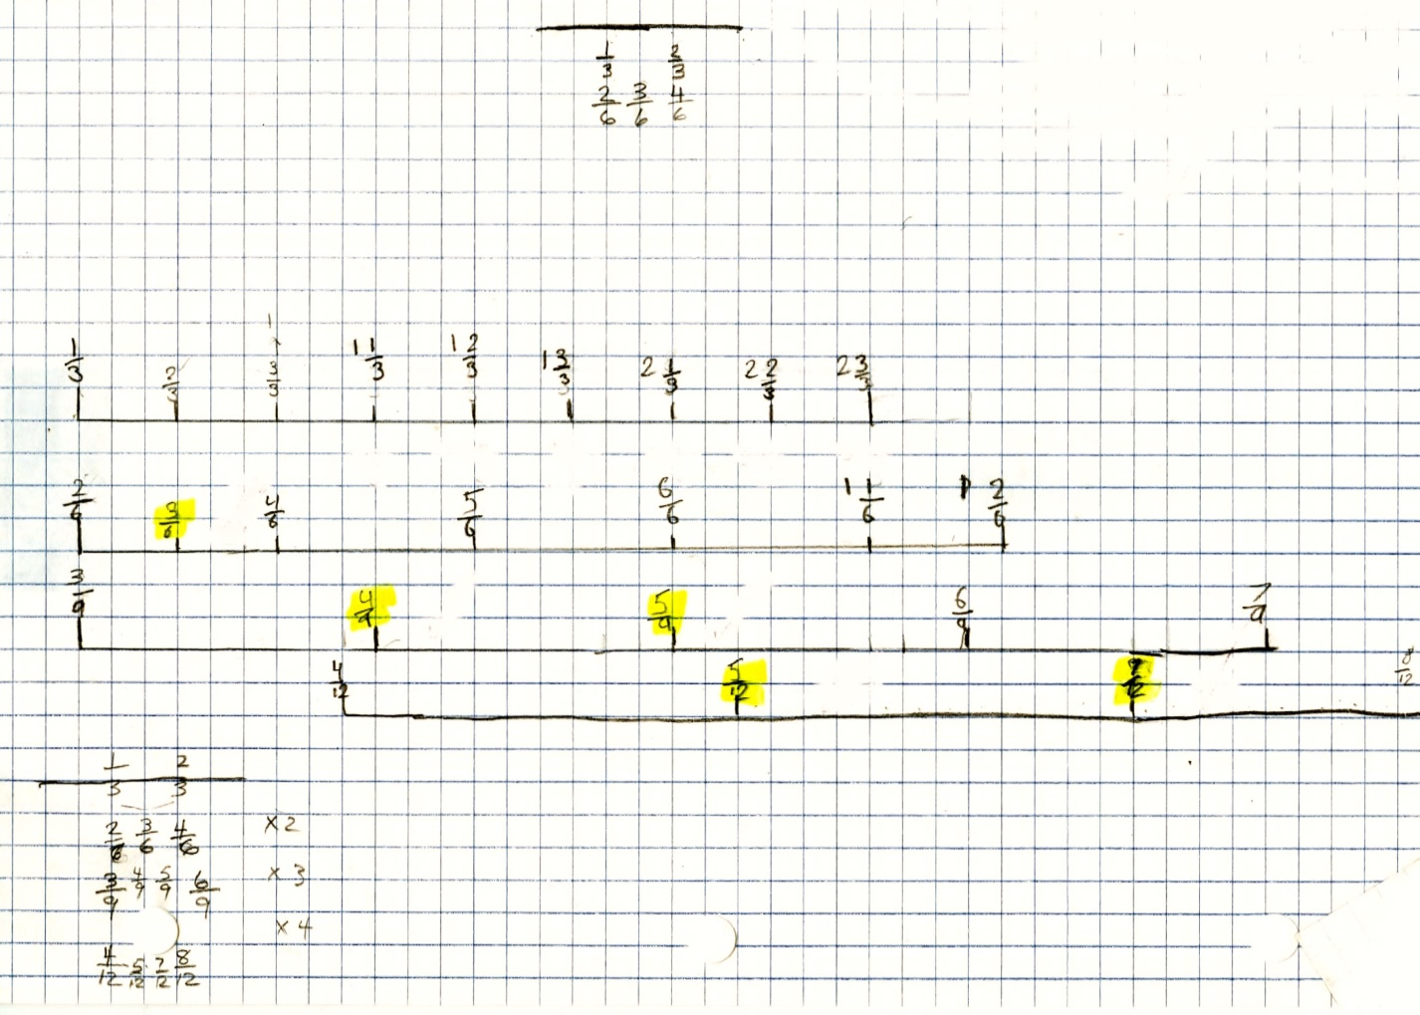
Student Thinking Sample #1
Notes:
We are going to show you seven different examples of student work (They are not numbered consecutively). At your table you only had a few of them. When we show an example that you have thought about please share your observations with the whole group. <<call on volunteers>>
Sample #1:
(what knowledge and skills are demonstrated)? <<know how to create equivalent fractions, know how to partition accurately>>
(what is unclear or unwritten?)<<since their number lines are not stacked so that the end values are equivalent, not clear if they understand equivalent fractions >>
(what knowledge and skills appear to be fragile or absent?) <<formatting of the number lines>>
What other observations would you add? <<student appeared to need a longer number line to partition smaller unit fractions>>

Slide 32
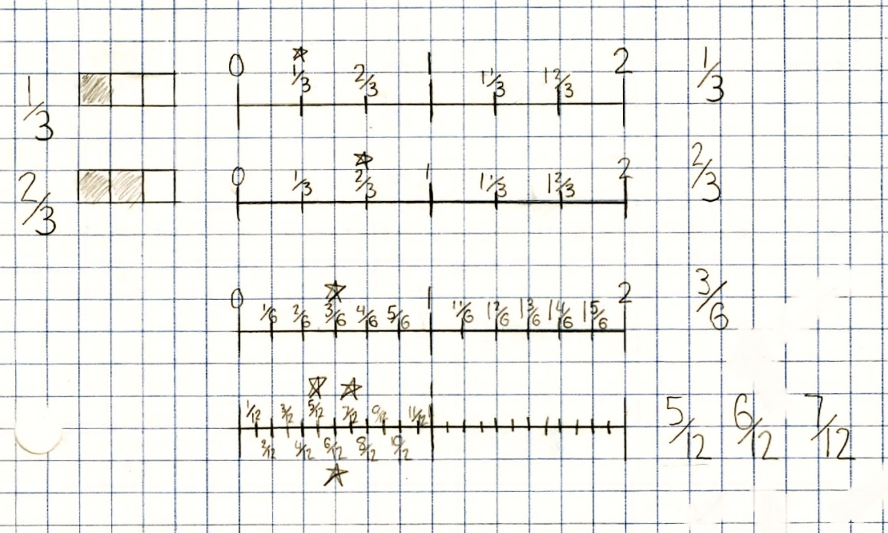
Student Thinking Sample #2
Notes:
Sample #2:
(what knowledge and skills are demonstrated)? <<understand equivalent fractions, partitioning, as evidenced by their stacked number lines>>
(what is unclear or unwritten?)<<the purpose of the rectangular representation of the area of 1/3 and 2/3>>
(what knowledge and skills appear to be fragile or absent?) <<>>
What other observations would you add? <<shows clear organized thinking>>

Slide 33
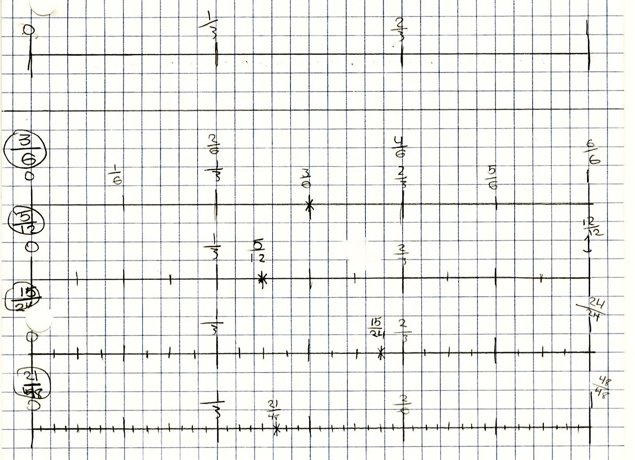
Student Thinking Sample #3
Notes:
Sample #3:
(what knowledge and skills are demonstrated)? <<understand equivalent fractions, partitioning, as evidenced by their stacked number lines, used equivalent fractions with denominators up to 48ths>>
(what is unclear or unwritten?)<< highlighted their answer with a star and a label but wrote the answer in a circle above zero>>
(what knowledge and skills appear to be fragile or absent?) <<>>
What other observations would you add? << number lines went from 0 to 1>>

Slide 34
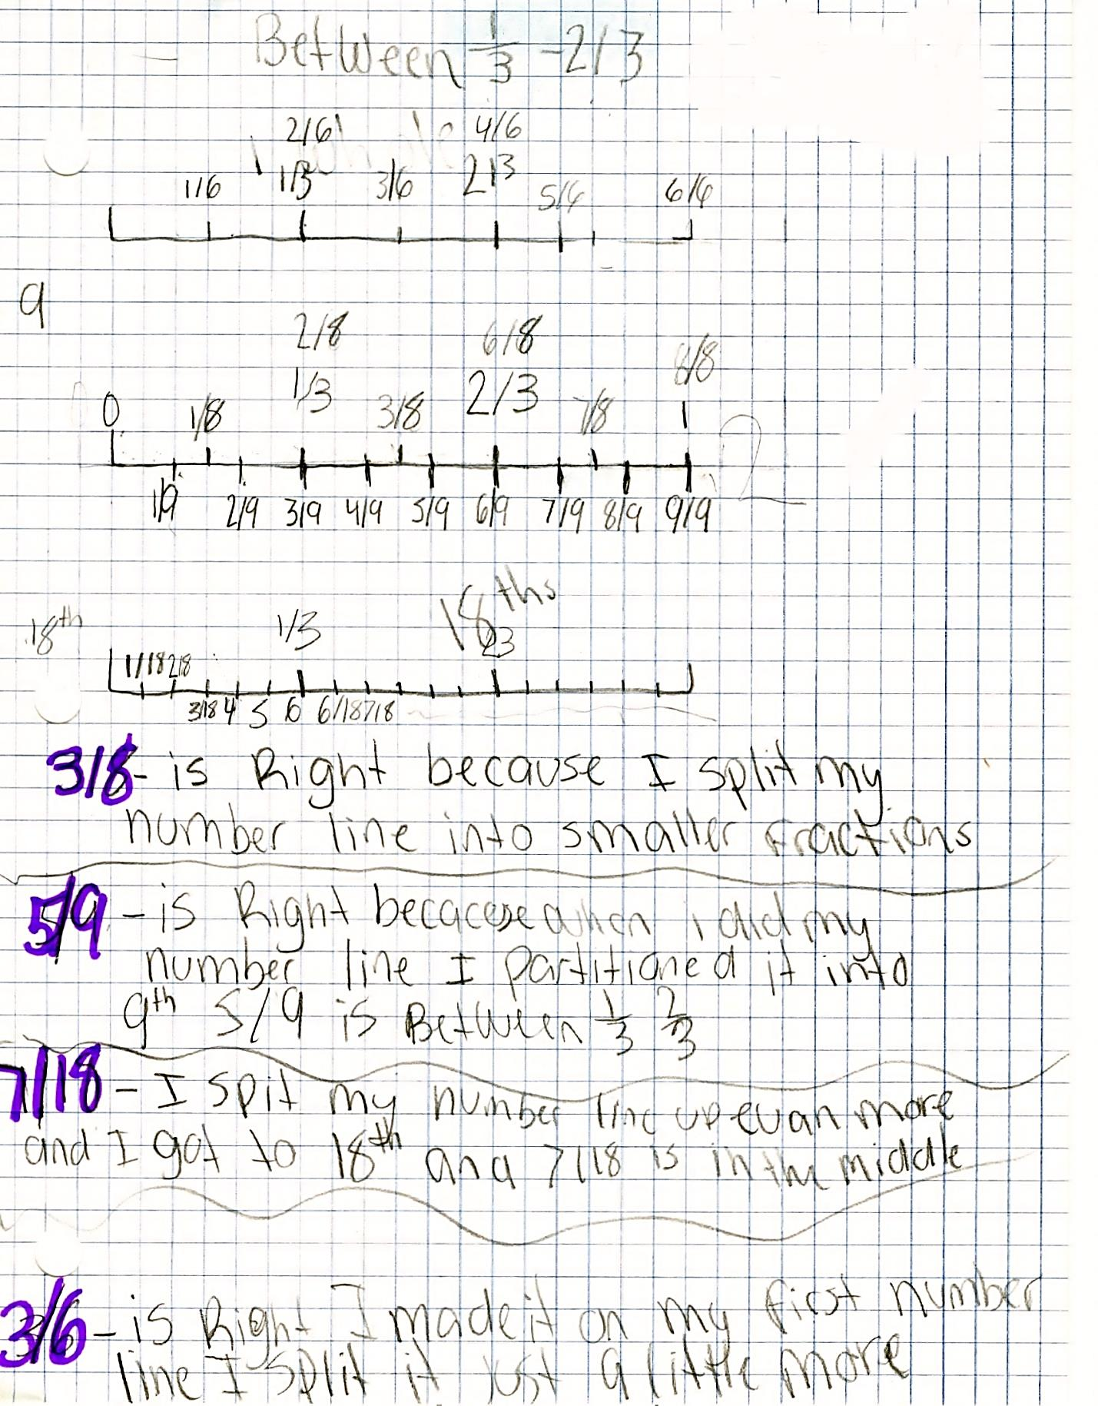
Student Thinking Sample #4
Notes:
Sample #4:
(what knowledge and skills are demonstrated)? <<the fractions placed are correct answers but they were not all placed accurately, drew number lines from 0 to 1, showed some understanding of partitioning>>
(what is unclear or unwritten?)<<student could work with multiples of threes but struggled with the eighths >>
(what knowledge and skills appear to be fragile or absent?) <<the communication of solutions referred to middle and not between>>
What other observations would you add? << annotated their thinking>>

Slide 35
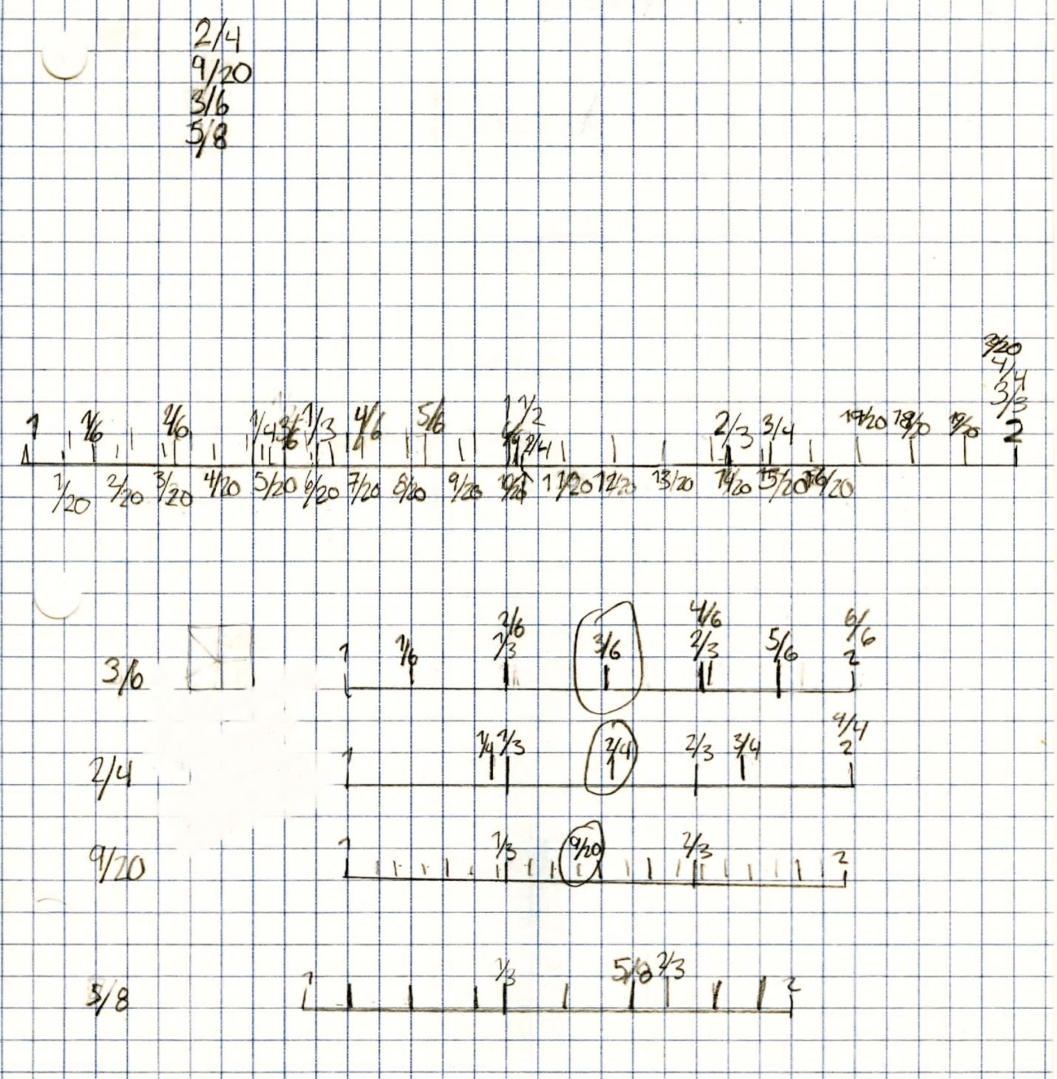
Student Thinking Sample #5
Notes:
Sample #5:
(what knowledge and skills are demonstrated)? <<found 3 correct answers, the fourth was equivalent to another, stacking of the number line for 1/3 and 2/3 is accurate>>
(what is unclear or unwritten?)<<why they chose denominators of 8ths and 20ths instead of multiples of 3>>
(what knowledge and skills appear to be fragile or absent?) <<endpoints on the number lines are mislabelled, partitioning is close but not exact, didn't choose partitions that were multiples of three>>
What other observations would you add? <<first number line might have been used to illustrate thinking>>

Slide 36
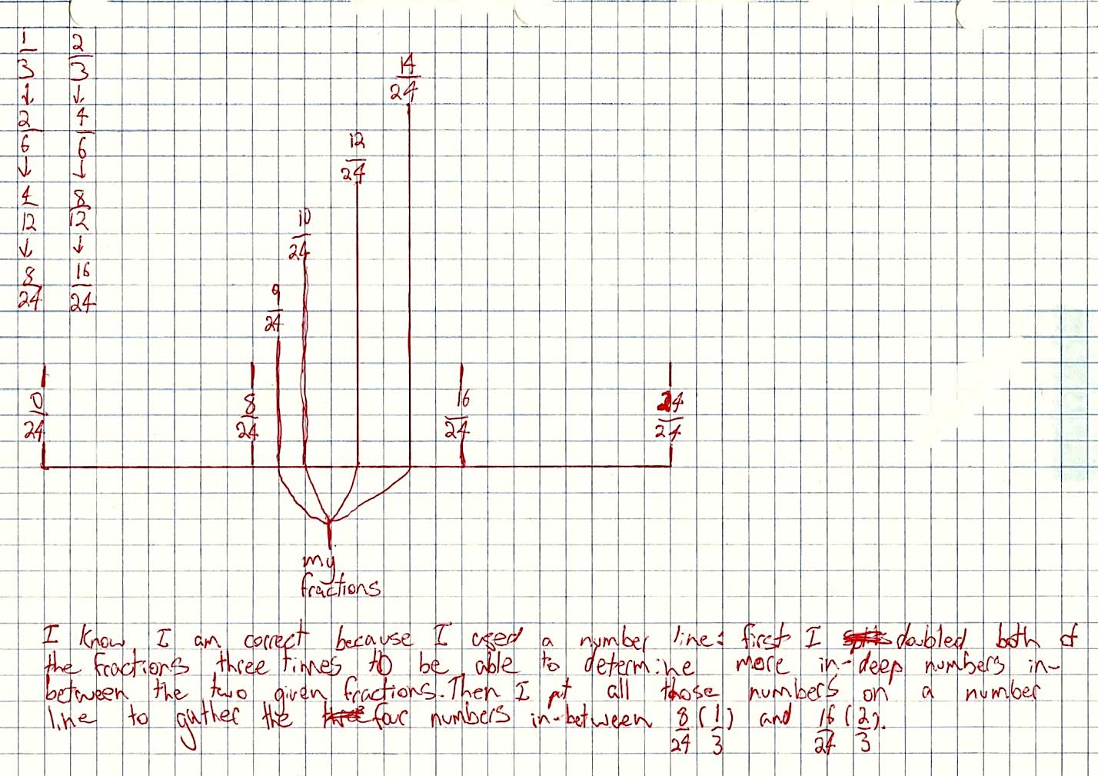
Student Thinking Sample #6
Notes:
Sample #6:
(what knowledge and skills are demonstrated)? <<clear understanding of doubling to get equivalent fractions, was aware that the task was about going deeper (In deep)>>
(what is unclear or unwritten?)<<no evidence of equivalent fractions beyond doubling>>
(what knowledge and skills appear to be fragile or absent?) <<>>
What other observations would you add? <<only one number line drawn, clear annotation of thinking>>

Slide 37
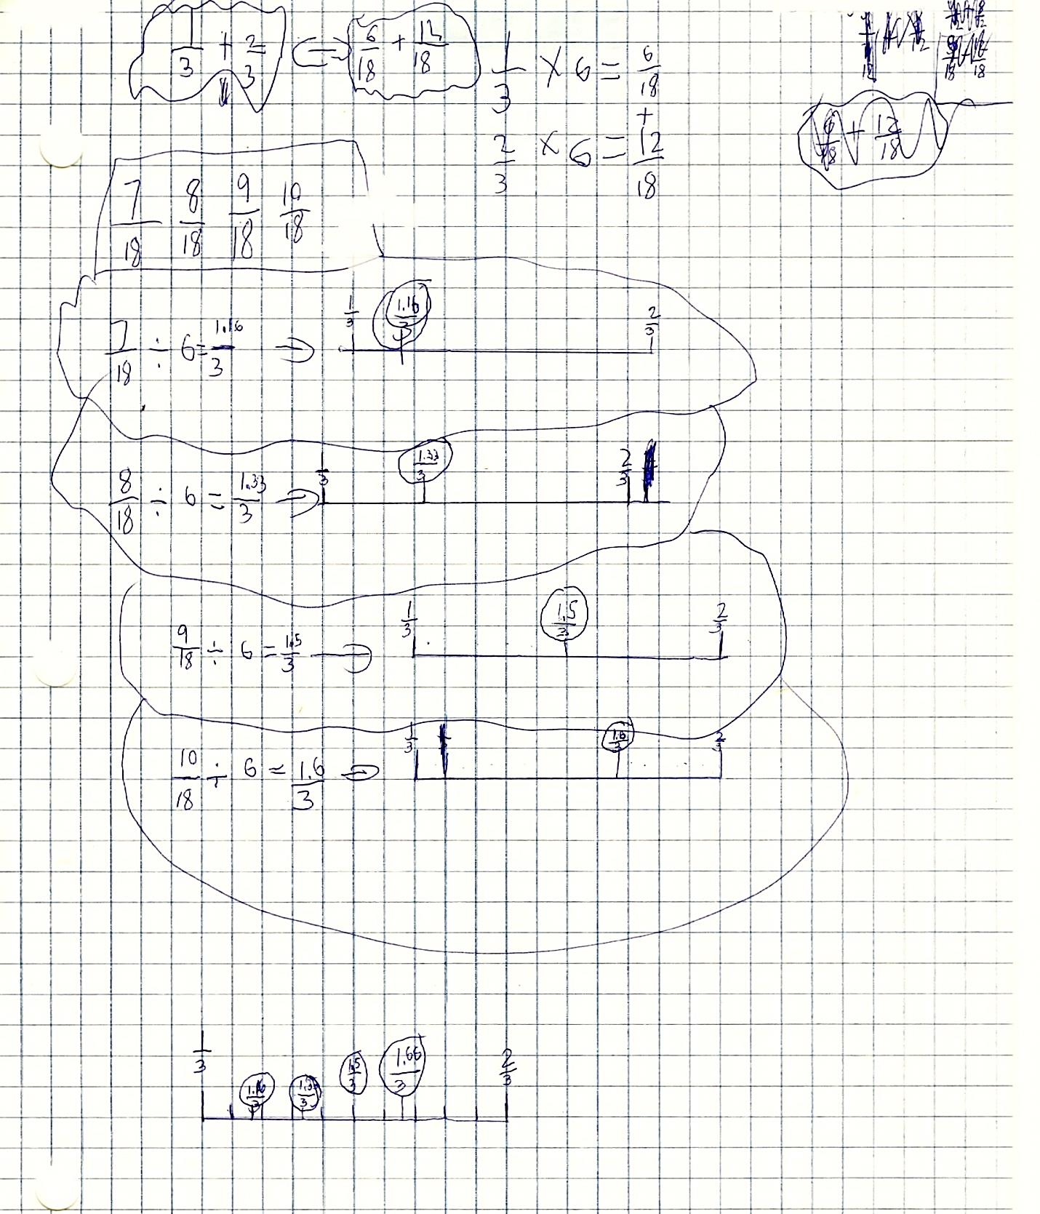
Student Thinking Sample #7
Notes:
Sample #7:
(what knowledge and skills are demonstrated)? <<located four correct fractions>>
(what is unclear or unwritten?)<<why they decided that answers needed to be in thirds and used decimal numerators>>
(what knowledge and skills appear to be fragile or absent?) <<created correct equivalents with incorrect symbolic operations>>
What other observations would you add? <<all number lines went from 1/3 to 2/3, they did not use the equivalent end values>>

Slide 38
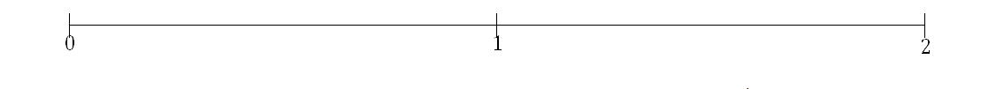
Using the Number Line
Linear representations such as the number line support the study of equivalent fractions, as any point on the line can represent and infinite number of equivalent fractions. Consider the location of two on this number line.
However, we can use other units to name it, such as halves, in which case it would be 4/2
Notes:
We know then that 2 = 4/2 <<four-halves>>. A whole can be partitioned into an infinite number of equi-partitions. Therefore, there are essentially an infinite number of equivalent fractions for any point on the number line. The exploration of equivalence allows students to develop an understanding of equivalent fractions as simply being a different way of naming the same quantity; it also supports them in viewing the fraction as a numeric value.

Slide 39
Precise Instructional Decisions
Introduce a new concept with a familiar representation, and introduce a new representation with a familiar concept.
For example, use a number line with primary students when first introducing unit fractions as they have experience with whole numbers on the line. Later, represent these same unit fractions when introducing a new model, such as a rectangle.
Paying Attention to Fractions, page 22
Notes:
This is from Paying Attention to Fractions, a support document for Paying Attention To Mathematics Education K – 12. We will be spending some time on this document later in the session.
We have included this slide here because it is so important to introduce only one new thing at a time, either a new concept or a new representation.

Slide 40
Understanding Equivalency
Notes:
Comparing fractional values requires a strong sense of equal partitions as well as equivalence. Research indicates that learning in the junior grades should focus on the comparison and ordering of fractions, including the determination of equivalent fractions using a variety of strategies (Petit et al., 2010). Students should have ample opportunity to consolidate their understanding of the meaning of a fraction prior to finding an equivalent fraction (Petit et al., 2010).

Slide 41
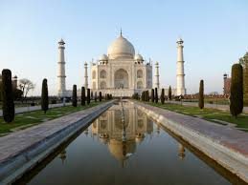

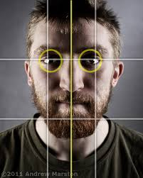

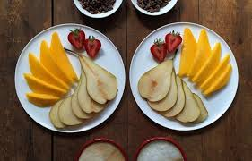
Equivalence at a Young Age
Notes:
Young children have an early intuitive sense of symmetry and balance, which is the concept of equivalence. We see this in architecture, nature and in the way we organize our own world (e.g., food, rooms, desks, etc).
<<Images are from Art Explosion disks>>

Slide 42
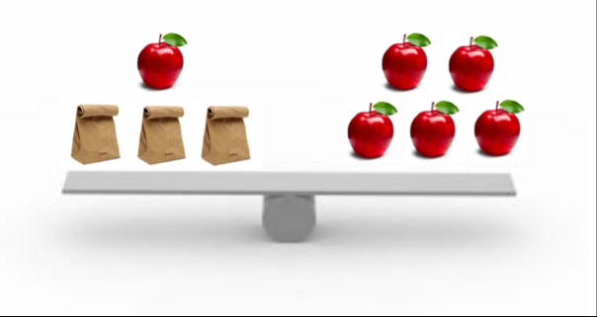
Equivalence as Balance
https://globalmathblog.wordpress.com/2015/
Notes:
In mathematics, we tend to reduce equivalence to the notion of a balance of equations but in the world the broader understanding of equivalence is ‘the same as’. In this visual a young student can make sense of the equivalence.

Slide 43
Avoiding Misconceptions about Equivalency
If students are prematurely or solely exposed to symbolic procedures for determining equivalent fractions they are prevented from connecting this procedure to the visual models. Being able to make such connections will allow them to connect equivalent fractions to their proportional reasoning skills and to whole numbers and decimals and support them in making sense of algebraic fractions in later grades.
Paying Attention to Fractions, page 17
Notes:
This is another research connection from Paying Attention to Fractions

Slide 44
Using Models for Equivalence
Construct a large rectangle on graph paper provided.
Partition your rectangle into fourths.
Shade in one one-fourth of your rectangle.
Now partition each of your fourths into thirds.
What fraction of the area is shaded using the new fractional unit?
Write a symbolic equation with these two fractions.
Notes:
This is the hands on task from the beginning of the session. At your tables talk about the symbolic connection to the concrete manipulation.
<<allow a few minutes for this>>
This is splitting – and connects to multiplying the symbolic version by 1 written as 3/3.

Slide 45
Merging for Equivalence
Write as many equivalent fractions as you can for the following fraction:
Notes:
Debrief from the Pre-session task.
<<Should be ¾ - -30/40 so can merge by 5s, 2s, 10s or else create new partitions e.g by halving to get 60/80>>

Slide 46
Research Connection
Think
Individually read pages 14-17 of PATF
Pair
Discuss
Share
At the table, create a summary on chart paper of the key ideas presented
Post around the room
Notes:
Now we are going to spend some time reading and discussing the equivalence section of Paying Attention to Fractions. <<explain the task>>
<<Provide Paying Attention to Fractions, one per person, as well as chart paper and markers on the table>>
<<Think 10 min, Pair 15 min, Share 20min>>

Slide 47
Comparison Task
Which is closer to ?
or
Explain your thinking.
Notes:
Now we are going to do a few comparison tasks. This is the first one that I would like you to work on at your table.
<<Ask a few participants to share their strategies. Be sure that at least one of the strategies uses a benchmark fraction. Remember to read the fractions as numbers – ‘twenty-eight nineteenths and twenty-six sixteenths’>>
<<correct answer is 28/19>>

Slide 48
Which is greater?
Which is greater : or How do you know?
Which is greater : or How do you know?
Notes:
Now we have two more. This is the first one. <<show first question and allow time to complete it; encourage the use of different models to answer the question, have people share.>>.
This is the second one. <<show second question and allow time to complete it>>
<<Highlight that the first question uses fractions with common denominators while the second uses common numerators.>>

Slide 49
Which is greater : or ? Explain your answer in two different ways.
Which is greater? (Continued)
For further information about the benefits of multiple solutions, see:
Journal for Research in Mathematics Education (NCTM)
July 2014
Do Multiple Solutions Matter? Prompting Multiple Solutions, Interest, Competence and Autonomy
Stanislaw Schukajlow and Andre Krug
Notes:
This is the final question. <<Allow time to complete and share solutions with the group. Solutions may include a rectangular array, number lines, common denominators, common numerators, decimals, and benchmarks.>>

Slide 50
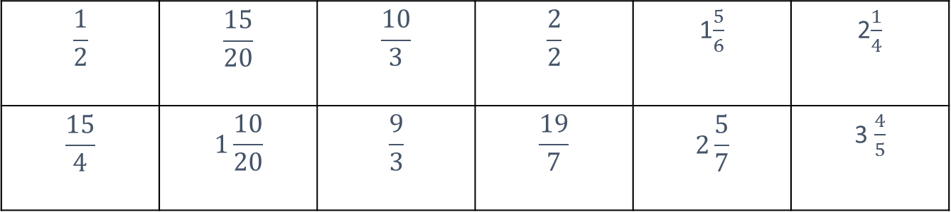
Using Benchmarks
Write each of these fractions on a sticky note.
Place each of the fractions on the number line, and prepare to justify your placements.
$$\frac{1}{2}$$ | $$\frac{15}{20}$$ | $$\frac{10}{3}$$ | $$\frac{2}{2}$$ | 1$\frac{5}{6}$ | 2$\frac{1}{4}$
$$\frac{15}{4}$$ | $$1\frac{10}{20}$$ | $$\frac{9}{3}$$ | $$\frac{19}{7}$$ | $$2\frac{5}{7}$$ | 3 $\frac{4}{5}$
Notes:
Now we will look at a number line task. Working in pairs, write each of these fractions on a sticky note and place it on a number line.
<<allow time to complete the task>>
Lessons similar to this one can be found on EduGAINS in the Professional Learning-Digital Paper-Resources section. There is a single lesson and a lesson bundle, which is useful for punctuated instruction.
<<Circulate to observe and anticipate misconceptions, for example: that ½ may be placed at 2. Prompt for this: if ½ is at 2 where would you place 1 5/6? The misconception here is that the whole is 4, but there is no context for this, ½ is a quantity based on the whole being 1, not an operator for ½ of 4.>>

Slide 51
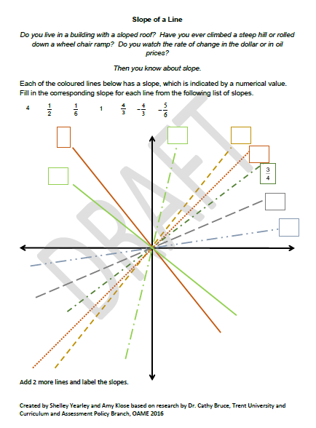
Comparing Fractions
Notes:
This is a secondary panel example that is similar to the previous activity. Students would order the fractions as slopes on the line.

Slide 52
Understanding Density
Notes:
We completed an activity earlier in this presentation that used partitioning to place fractions between two given fractions. This activity is a good basis for thinking about density of fractions which we will explore in this next section.

Slide 53
Connections of Density of Fractions
The concept of density of [fractions] is applied when making measuring tools for different purposes.
For example, a carpenter building a barn would be content with accuracy to the nearest eighth of an inch. However, a cabinet maker would not.
The cabinet maker would need accuracy to thirty-seconds of an inch….
However, thirty-seconds of an inch would be wholly inadequate for making electronic components as electronic components need to be accurate to microns (forty millionth of an inch).
Imagine the repartitioning necessary to go from a thirty-second of an inch to a forty millionth of an inch.
(Petit, Laird, & Marsden, 2010, p. 124)
Notes:
<<Petit, Laird and Marsden wrote “A Focus on Fractions: Bringing Research to the Classroom”. Read the quote.>>
These are all authentic applications of fraction use in the world. This is why we must expose students to conceptual understanding rather than mere procedures.

Slide 54
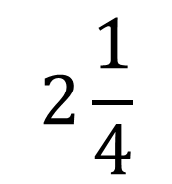
Finding a Fraction Between Two Fractions
What fraction could come between those two fractions? Convince a partner that your choice is correct.
?
$$2\frac{1}{4}$$
Notes:
Think of a fraction between the two shown and share with your group. Discuss the strategies that you used.
<<Encourage participants to reason and prove without using pencil/paper. Consider how benchmark fractions help with this.>>

Slide 55
And now…
Identify all the fractions between 1/5 and ¼.
Notes:
Think about your answer to this instruction. <<about 30 seconds>>

Slide 56
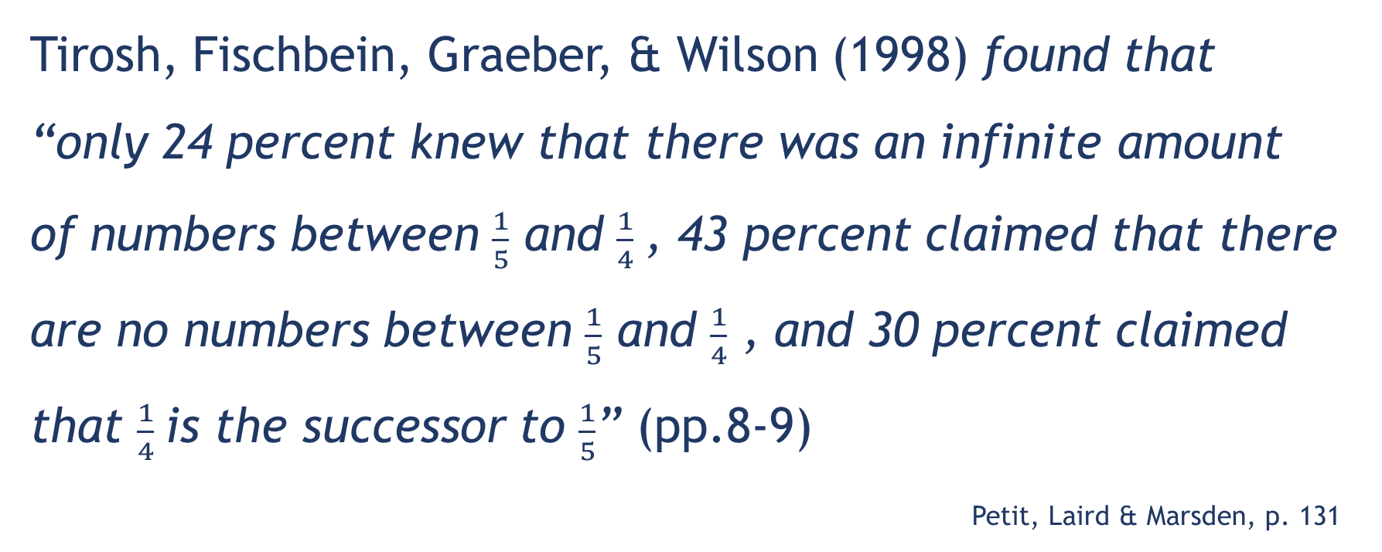
Emphasizing the Density of Fractions
Tirosh, Fischbein, Graeber, & Wilson (1998) found that “only 24 percent knew that there was an infinite amount of numbers between $\frac{1}{5}$ and $\frac{1}{4}$, 43 percent claimed that there are no numbers between $\frac{1}{5}$ and $\frac{1}{4}$ , and 30 percent claimed that $\frac{1}{4}$is the successor to $\frac{1}{5}$” (pp.8-9)
Petit, Laird & Marsden, p. 131
Notes:
<<The answer to the previous slide will appear on this slide. Ask participants to use thumbs up if they agree with the answer and thumbs down if they disagree. Take a quick look to see the results. (note that the answer is hidden behind the text – view as a presentation to see animation)>>.
<<Click>>
This is referring to educated adults (with a university degree).
<<Have participants read quietly and discuss with an elbow partner.>> Comments?

Slide 57

Connecting Unit Fractions and Comparing Fractions
Notes:
This slide shows the connections of the work we’ve done in the first three sessions up to this point and the connections that unit fractions and comparing fractions makes to operations with fractions namely addition and subtraction.
<<click through to show the cell connections>>

Slide 58
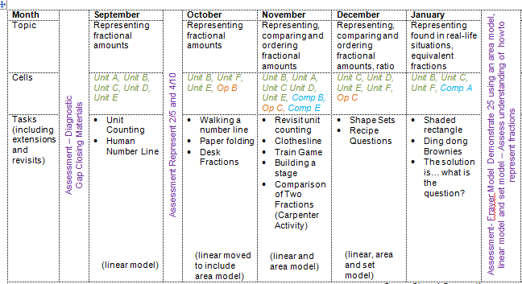
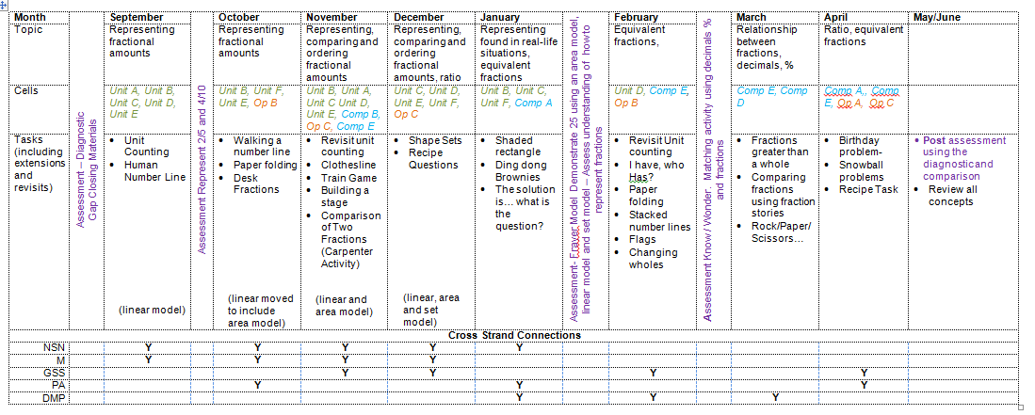
Punctuated Learning…
DRAFT Punctuated Instruction Map for Grade 5/6
Created by Ontario Classroom Teachers
Based on research with Dr. Cathy Bruce and the Curriculum and Assessment Policy Branch
Notes:
Teachers in the research project used a punctuated learning model. They created this course of study that shows fraction learning throughout the year. <<click>>This is a closer look at September to January. You can see that they visited the fraction concepts often and didn’t teach fractions as an independent unit. Their plan also references the cells in the fraction pathways that they were working on.

Slide 59
What Students Said About Punctuated Fractions Instruction
One teacher asked her 19 grade 4 students:
Did you like learning math this way?
2 students said no
1 student response was unclear
16 students said yes
Student A:
I do not like learning math when one week we do this and the other week we that. I like doing math when we do 1 part at a time.
Student B:
I like learning math this was because we’re not just learning one specific thing at one time, we’re learning a bunch of things together. This is a easier and more fun way of learning. I have definitely learned a lot more that way.
Student C:
I do not like learning this way, I love it because it makes me focus on more than one thing. It also helps me by if I do one unit at a time I might forget it or what we are learning.
Notes:
<<Read through the slide.>>
Student A did not write one of the pre or post assessments.
Student B scored 34% on the pre and 55% on the post.
Student C scored 47% on the pre and 61% on the post.
The students who wrote both pre and post improved from an average of 36% to an average of 56%.

Slide 60
Comparing Fractions across the K-12 Curriculum
Identify an expectation from the grade you teach from the page provided.
Read the section above the expectation.
Identify a question or task that you have used in your classroom which addresses that expectation.
Discuss with your table mates.
Notes:
<<Distribute BLM 3 Comparing Fractions Across the K to 12 Curriculum, one per person>>
Now we will connect the role of unit fractions in your specific grade curriculum.
<<You may choose to group the participants by grade or have a cross-section of grades for the discussion. This is a good summary of the concepts that were presented today. Highlight the connections of the ideas across the different grades.>>

Slide 61

Resources
Developed by Ontario teachers
Informed by current educational research
Field tested in Ontario classrooms
Responsive to feedback
Free
Free from advertisements
Notes:
We are going online to explore some learning tools on Mathies.ca

Slide 62
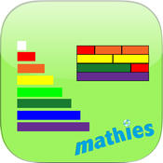


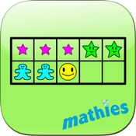
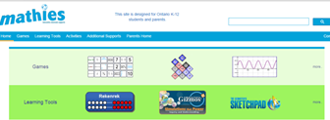
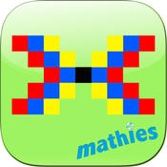
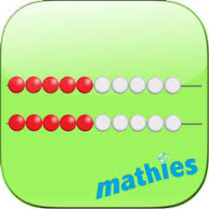
Exploring Representations
Mobile Device
Install from Store
Relational Rods+ by mathies
Set by mathies
Colour Tiles by mathies
Rekenrek by mathies
Puffin Academy (optional - to access our older stuff) - see http://mathclips.wikispaces.com/Using+Flash+on+Mobile
Adobe AIR (for Android).
Laptop
Check to see that you can access mathies.ca
Learning Tools
Notes:
<<Need at least one device per pair>>
On the left are instructions for accessing Mathies.ca from a mobile device and on the right from a laptop. Open or download for your device.

Slide 63
Exploring mathies.ca Learning Tools
Log on
Select ‘Learning Tools’
Select ‘Select a Topic’, ‘Fractions’ comes up first
Choose a tool and open it
Notes:
This is the exploration. We will look at the next slide before you begin your exploration

Slide 64

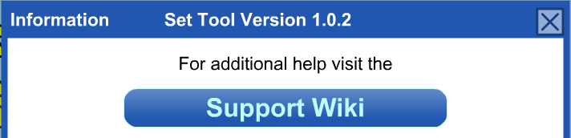
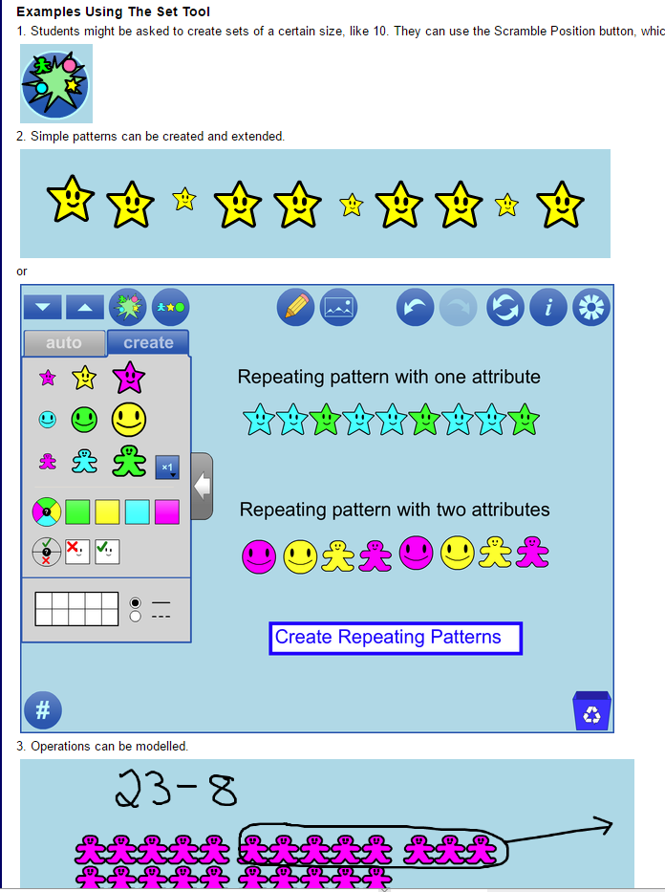

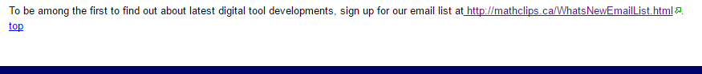
Information and Supports
Scroll to the bottom of the page for a link to our email list.
http://mathclips.ca/WhatsNewEmailList.html
Notes:
The (i) button gives access to support wiki, with link to our email list.
The Feedback form gives you direct access to the team anytime - feature requests, bug reports etc.
The direct link to the email list is also at the bottom of the session feedback form.

Slide 65
Time to Explore
Play with the tools to see how they might be used to solve some of the fraction tasks we have worked on earlier or others of your choosing
Think about some classroom activities that could be supported with these tools
Note that the Fraction Number Line tool is not yet available
Have fun!
Notes:
You can now use the rest of the time to explore.
<<should have at least an hour>>

Slide 66
Feedback and Comments
How do the mathies tools support conceptual understanding?
How can you include them in your instruction?
Notes:
<<Read the questions. Allow participants to share their responses to the questions.>>

Slide 67
Visit fractionsteaching.ca
Notes:
Remember that all the fractions resources are located at fractionsteaching.ca
Please continue your learning by visiting fractionsteaching.ca. Note that you can access the Fractions Learning Pathways by clicking on the image at the top.
Thank you for your participation today.

